Slide 1
ENA data submission
Zed chen 17/04/2026

Slide 2
study
Sample 1
run 1
Sample 2
Sample 3
run 3’’
run 2
run 3
run 3’

Slide 3
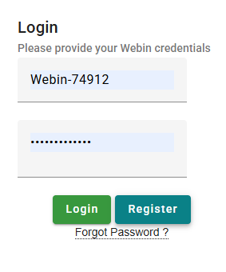
Register an ENA account
We don’t have an official ENA account for RBGE
And it doesn’t hurt to have an account of your own
https://www.ebi.ac.uk/ena/submit/webin/login

Slide 4
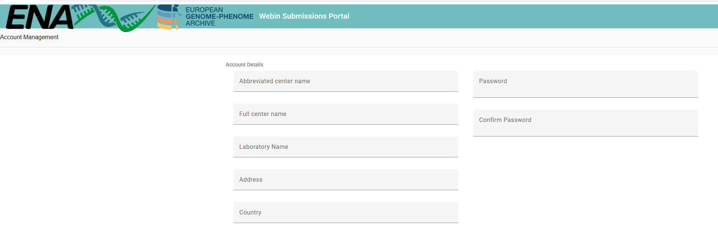
Register an ENA account
Remember to save your webin login details…

Slide 5
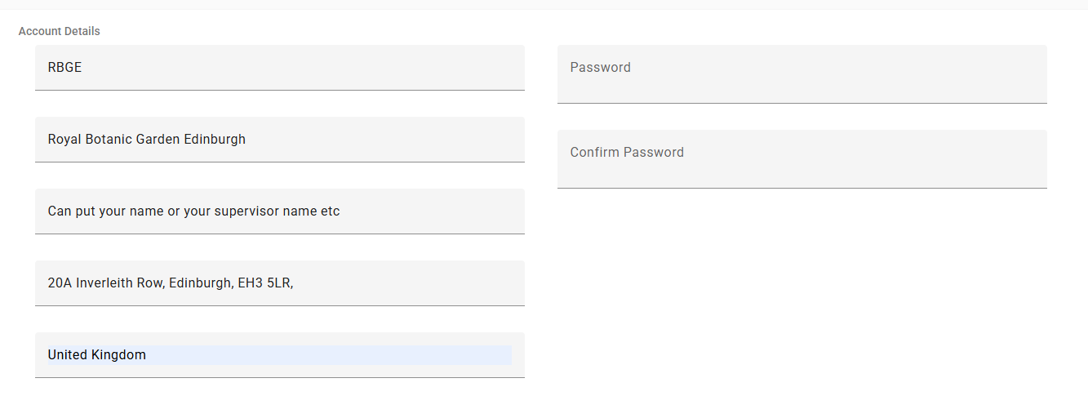
Register an ENA account
Remember to save your webin login details…

Slide 6
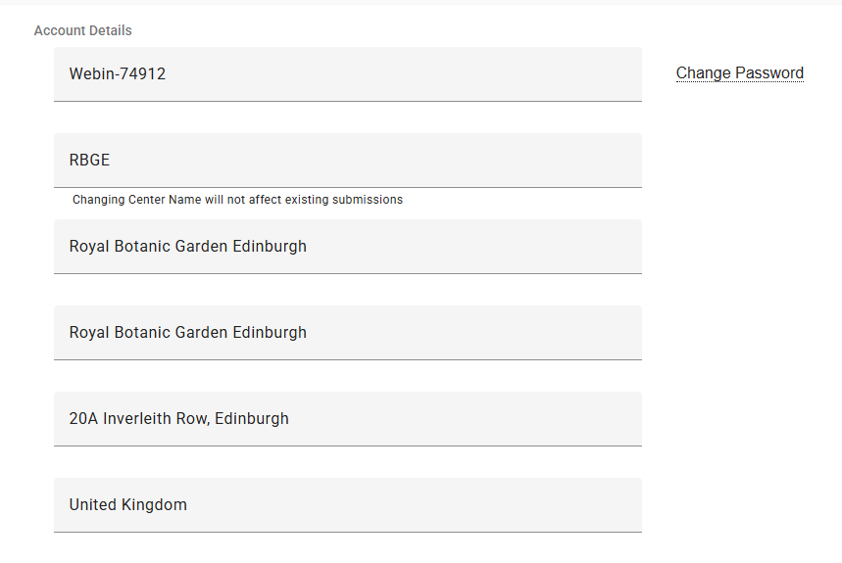
Register an ENA account
For instance, This one is registered with the lab name Royal Botanic Garden Edinburgh

Slide 7
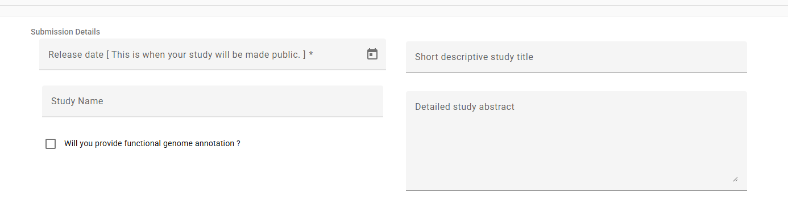
Register study

Slide 8
Register samples
Here comes the potentially troublesome part…
→ other checklist
→ ENA default sample checklist
→ ENA Crop Plant sample enhanced annotation checklist
→ ENA Plant Sample Checklist
→ Tree of Life Checklist

Slide 9
Register environmental samples
Here comes the potentially troublesome part…
→ Environmental Checklists
→ENA marker sequence checklist (meta barcoding)
ENA binned metagenome (metagenomic assembly)
GSC XXX… (for your reads, choose a most relevant environment, air, water, etc.)

Slide 10
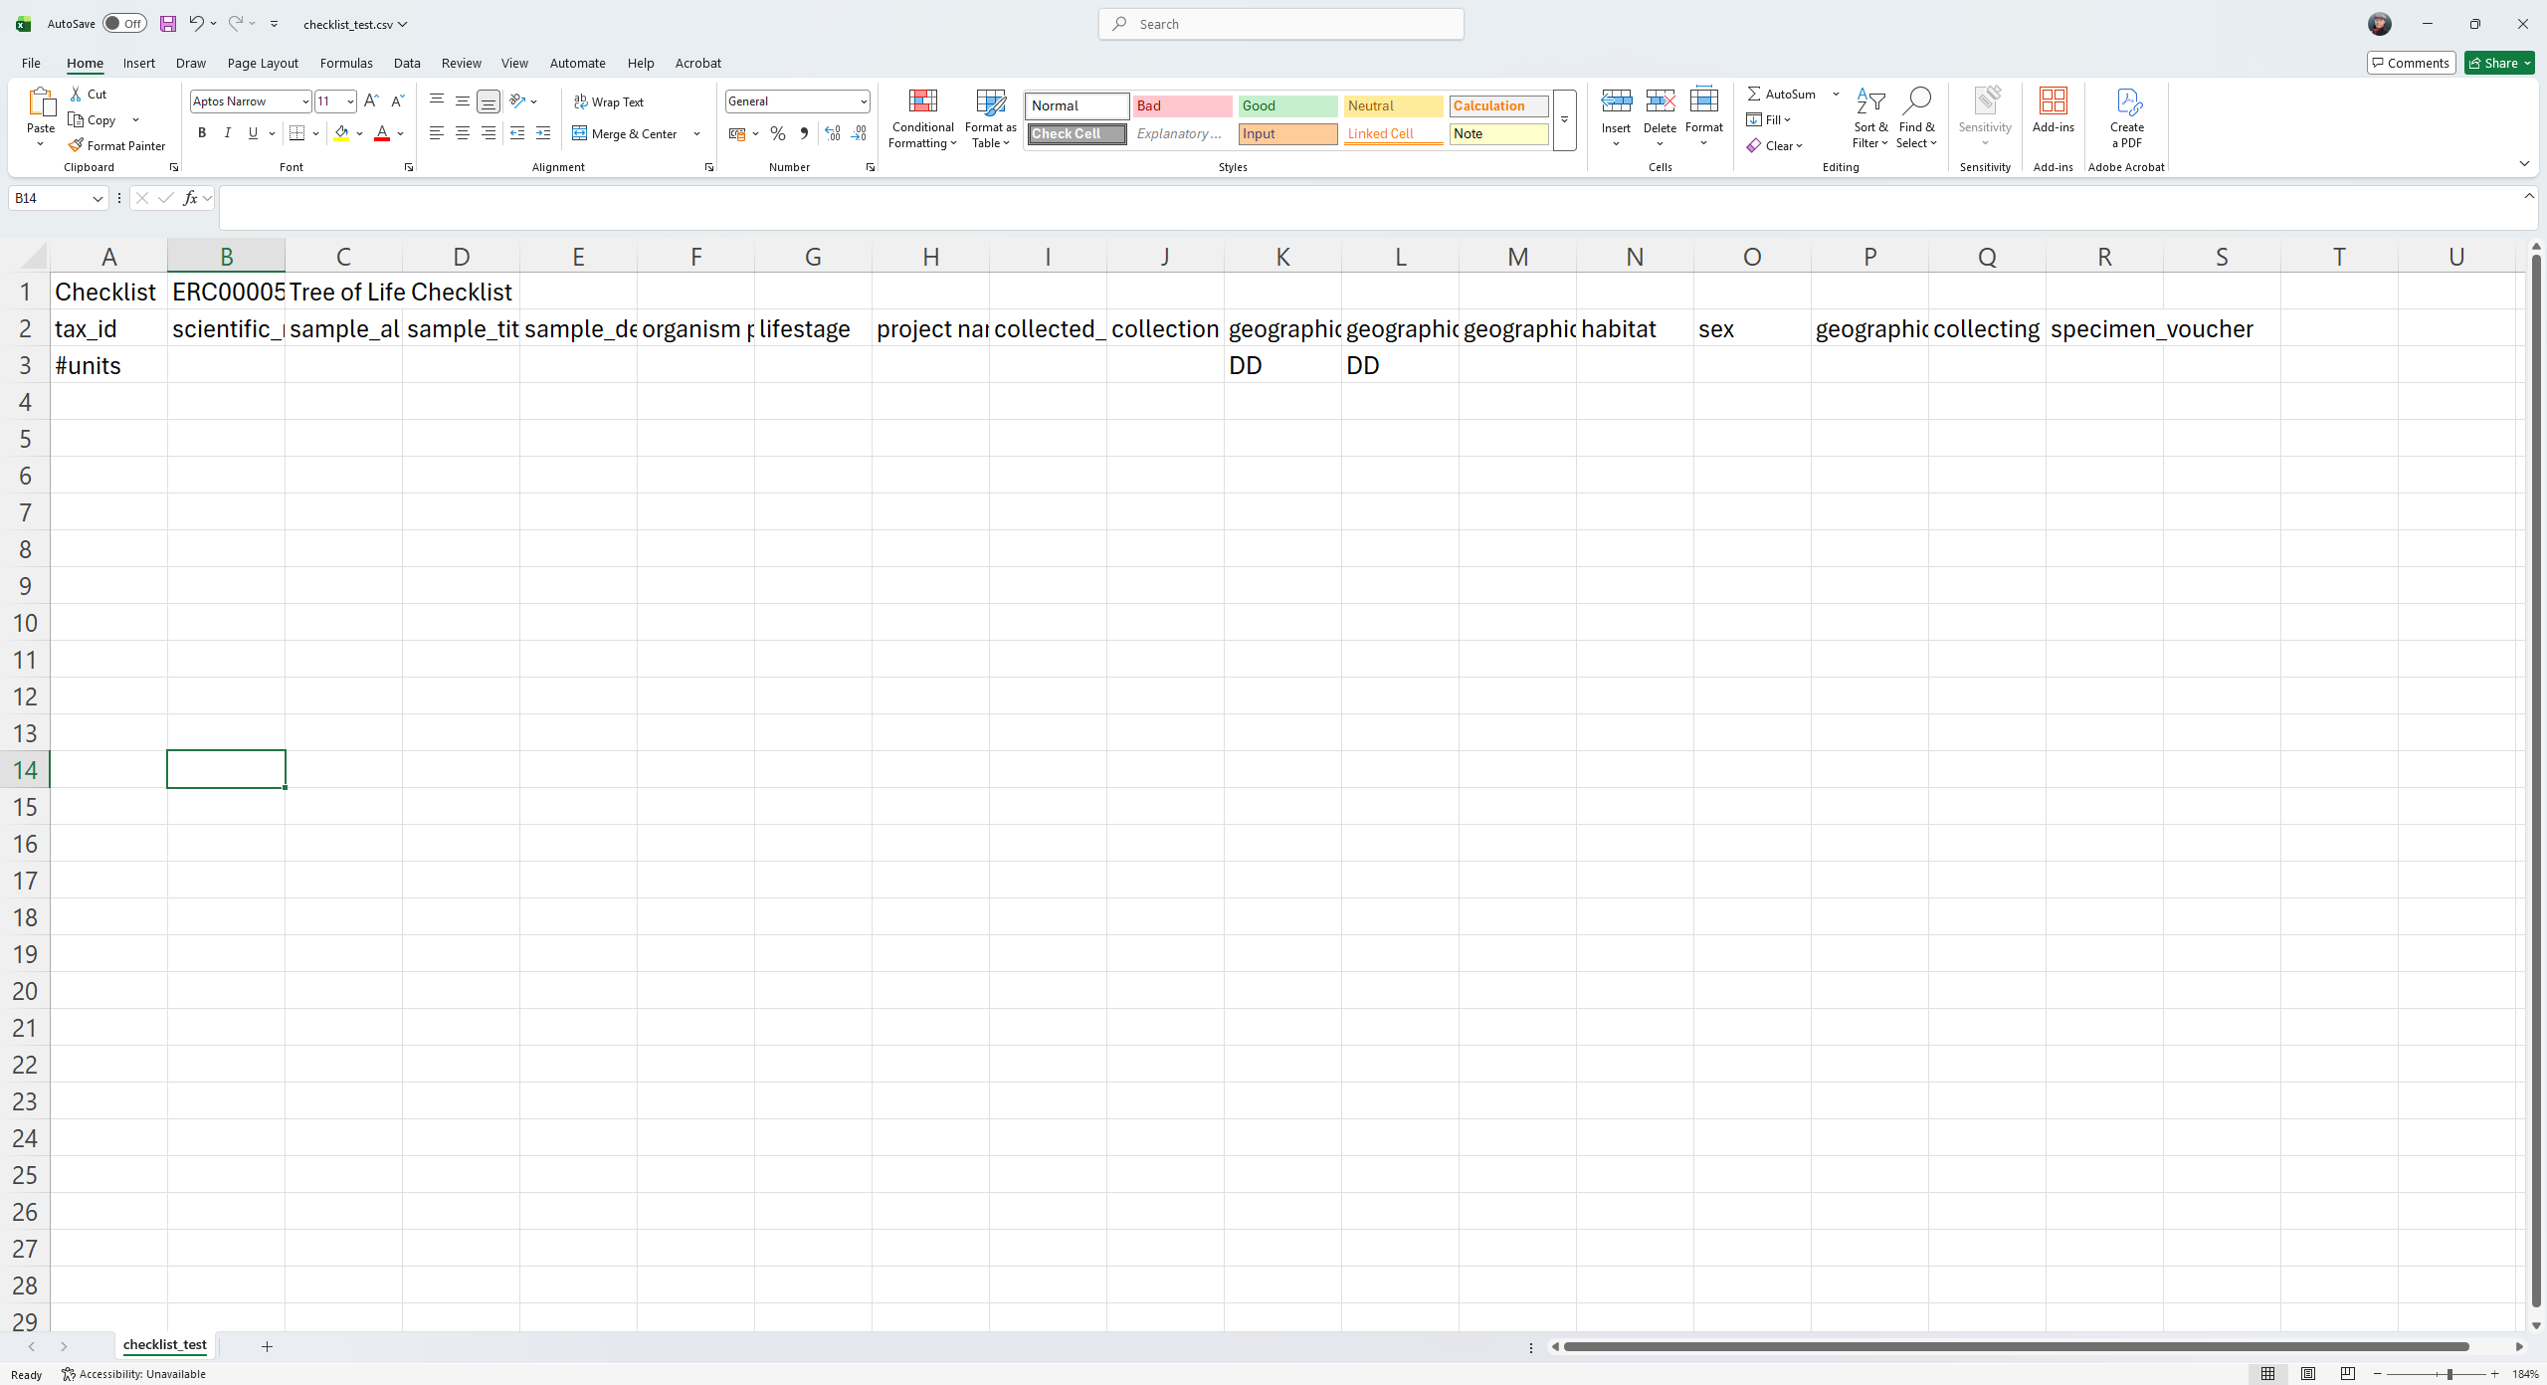
Checklist: Tree of Life Checklist
Using Tree of Life Checklist as an example
The download is in tsv format
Having a look at the required fields. This also tells you what are necessary for your metadata management

Slide 11
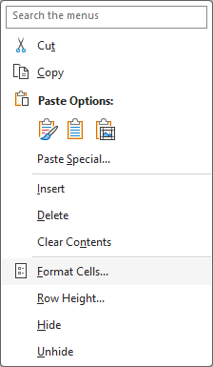
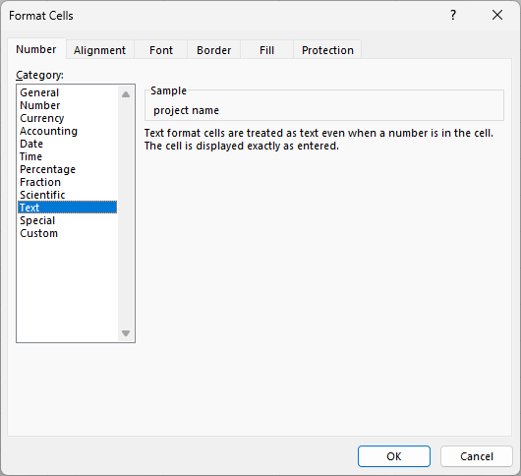
Populating the tsv
For easier manipulation, we can copy the titles into a comma delimited csv
To stop excel doing anything ‘smart’ by itself, format the cells to ‘Text’:
This way it does not reformat your date etc automatically
Select all→ click right → format cells → Text

Slide 12
Sample checklist
ENA has permitted values/required formats for many fields, so check the web page as you fill the form. Make sure it’s identical (or just copy and paste)
E.g.
Lifestage
gemetophyte
sporophyte
embryo
Etc. etc.
collection date
There’s a specific format (regular expression): 2008-01-23
geographic location

Slide 13
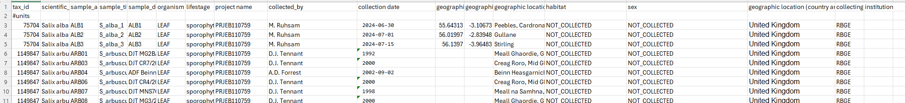
Sample checklist: an example

Slide 14
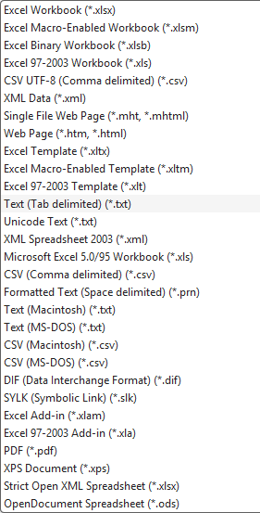
Formatting metadata file
Convert comma delimited csv to tsv (command line)
sed 's/,/\t/g’ YOUR_CSV.csv > YOUR_TSV.tsv
Convert: save as Text (Tab delimited) → rename surfix to tsv (ENA can only support tsv)

Slide 15
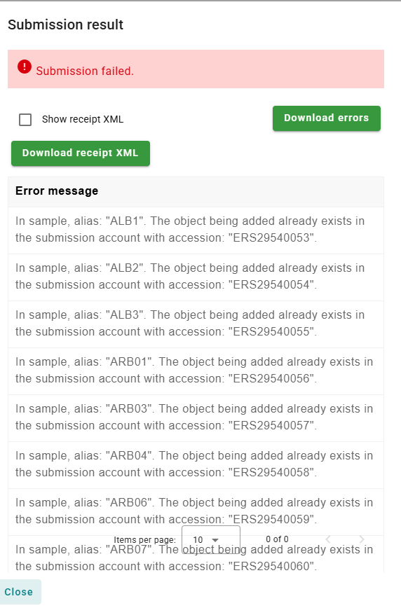
Each sample can only be registered once and get one accession

Slide 16
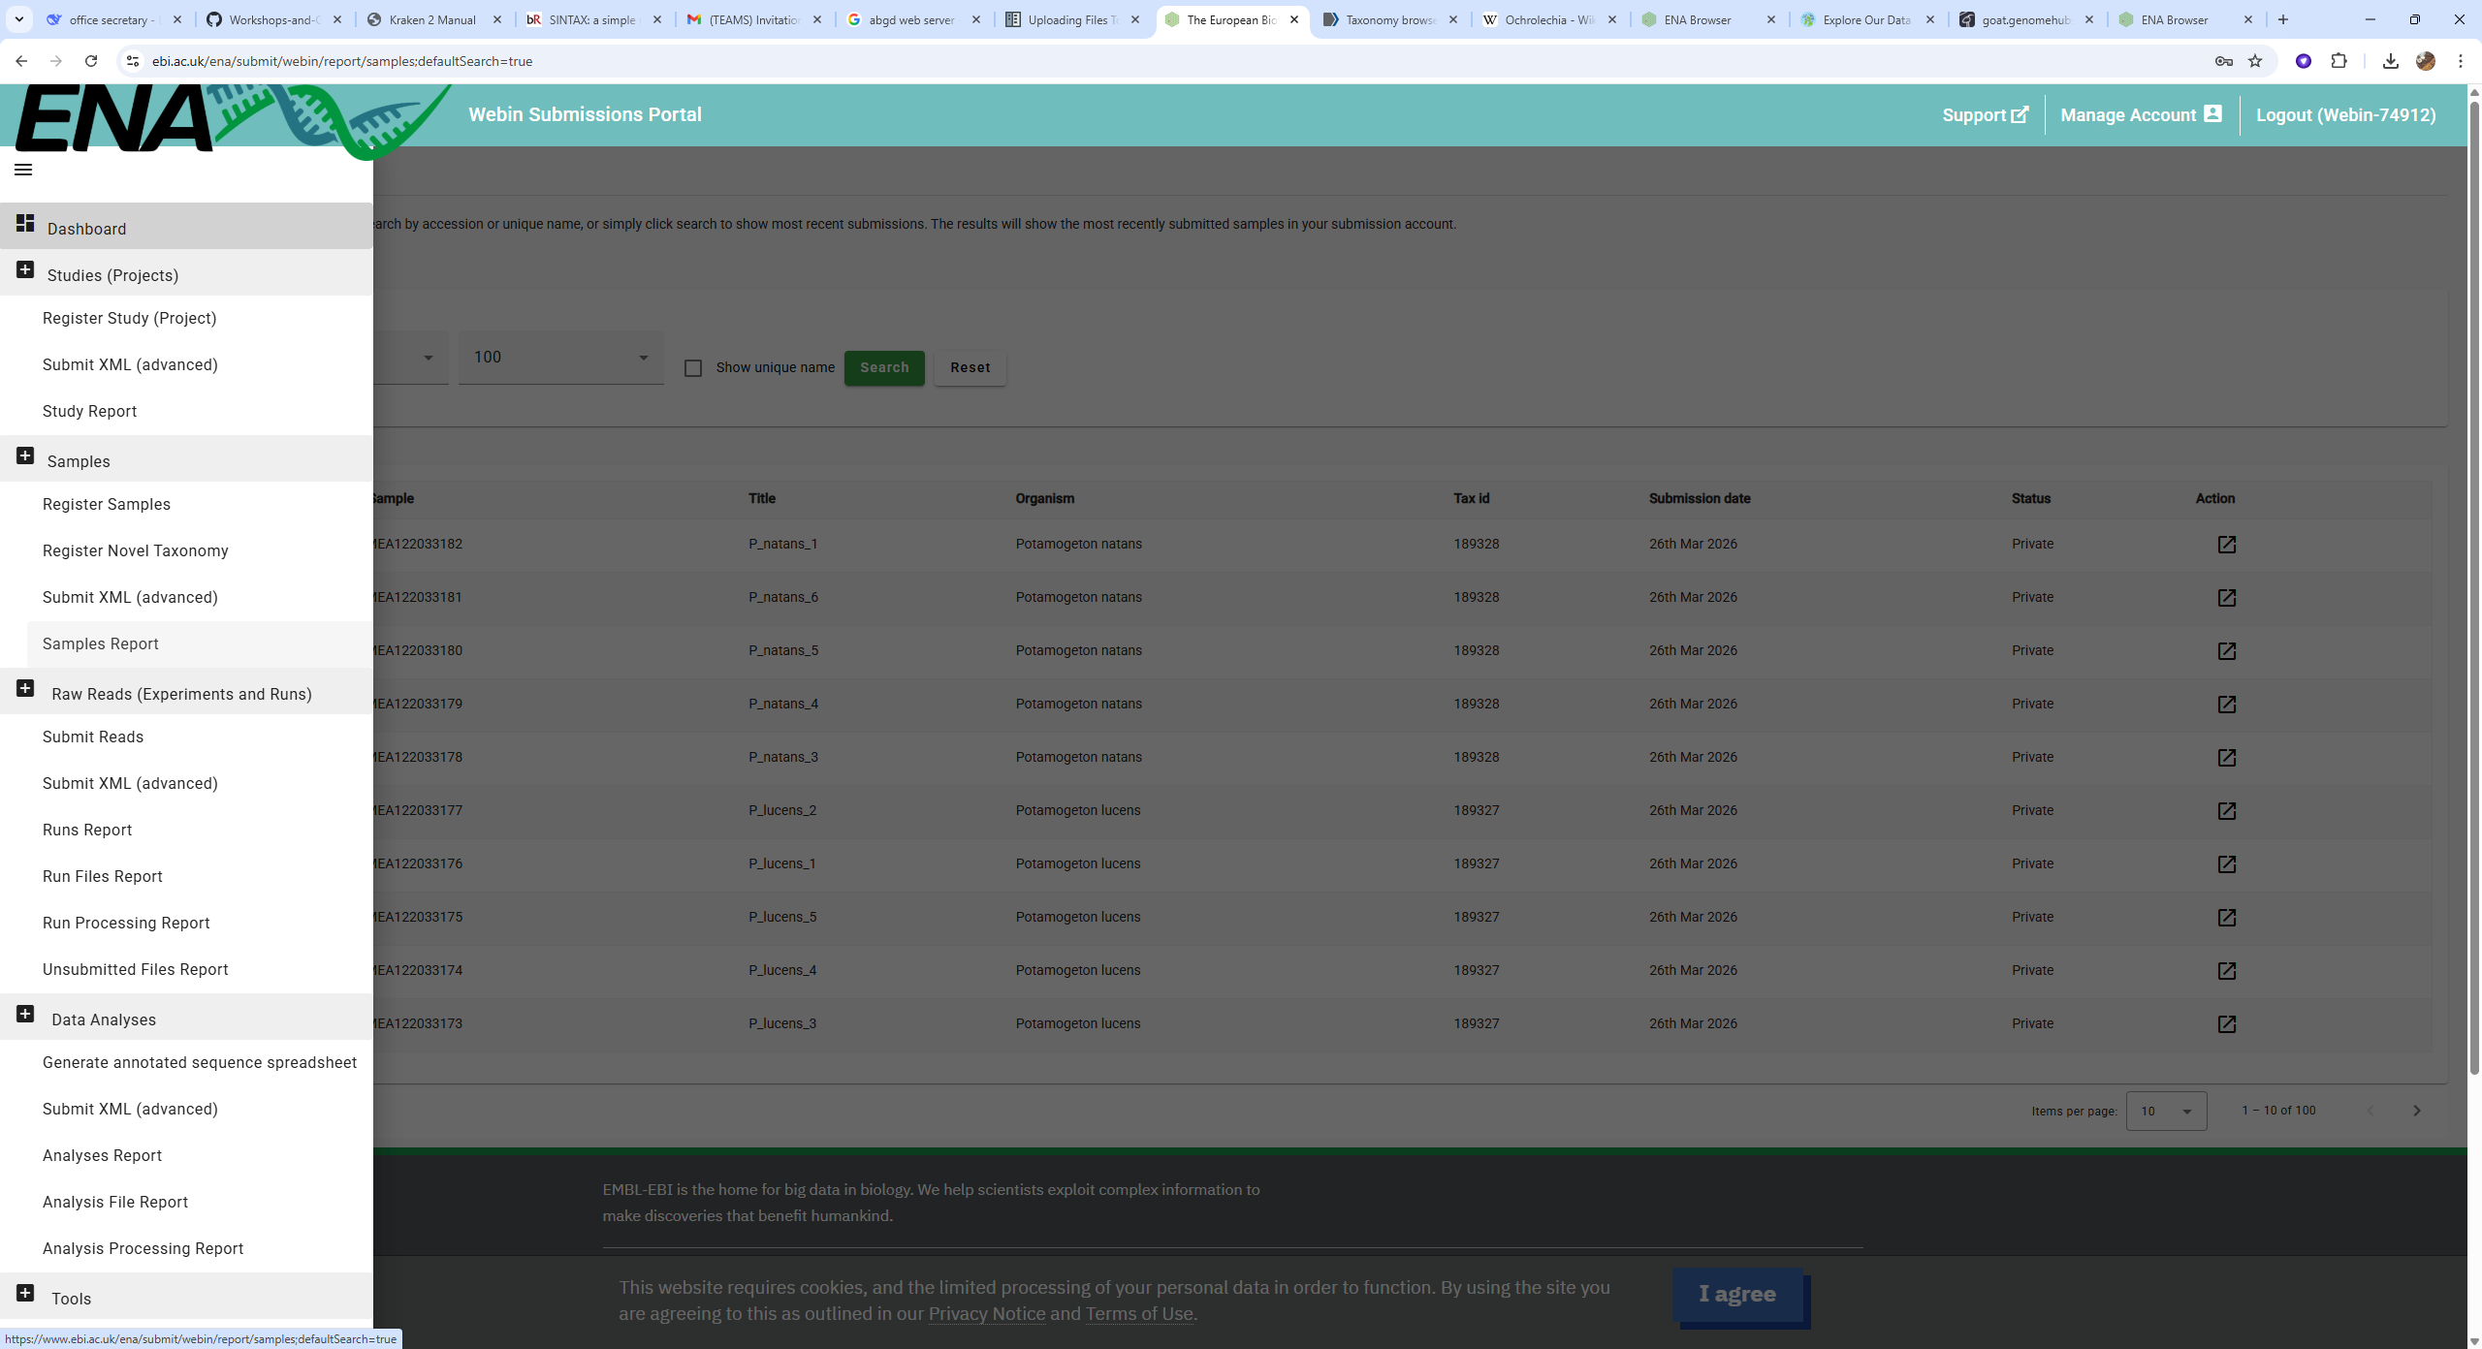
Sample report: check what samples have you registered (and a quick way to download accessions)

Slide 17
Submit reads/data to ENA
So this step links your uploaded file to the samples you have registered
You are submitting a metadata sheet basically
ENA will check the sheet against the data and validate your submission (or disapprove your submission…)

Slide 18
Use raw read submission as an example
Even if you might not be planning on submitting data soon, it could be a good idea to download a spreadsheet and check if any fields in meta data is missing
You can use it as a general guideline for metadata management

Slide 19
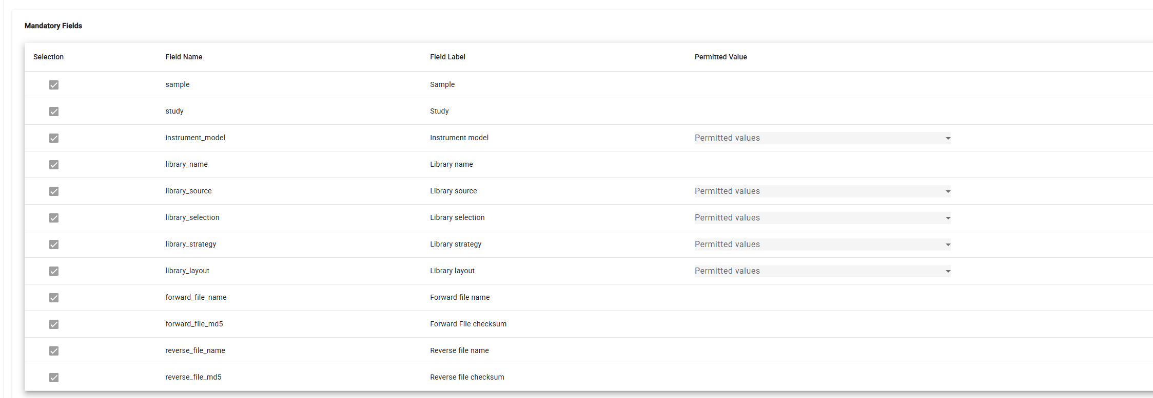
Raw read submission
Sample accession
Study accession
Well I put the sample alias (unique identifier on tube)
Should be from original sequencing company
Should be from original sequencing company

Slide 20
What’s MD5
MD5 (Message-Digest Algorithm 5) is a widely used cryptographic hash function that converts input data of any size into a fixed-length 128-bit (32-character hexadecimal) "fingerprint" or hash. It is primarily used for file integrity checks and data verification, but it is considered insecure for password storage or cryptographic security due to collision vulnerabilities.

Slide 21
Where to find MD5
You should double check MD5 when uploading data to dataheap or downloading from NovoGene etc
MD5 is provided in their downloading package:
One for the entire tar file:
62c0243dd9f40ea44ff9eb82e8e248d7 X204SC26013133-Z01-F003.tar
Within the tar file, one MD5 file for all files
Within the individual sample directory, one MD5 file for the sample itself
The MD5 files should be included in dataheap record along with metadata
You’ll never know if a file is exactly the same as the original file unless you still have the original MD5

Slide 22
Calculate MD5
MD5 can be calculated in CML simply with:
md5sum $FILE
It takes a while, so you might want to use a screen session
You can also use a for loop to get MD5 for all files at once and record the result:
for file in /mnt/shared/projects/rbge/willow/45926*fq.gz
> do
> md5sum $file
> done > old_salix_MD5.txt &
The & makes the program running in background so you can keep doing other things.

Slide 23
Upload files to ENA
https://ena-docs.readthedocs.io/en/latest/submit/fileprep/upload.html#uploading-files-using-command-line-ftp-client
The easiest way is probably to use lftp
If you are on Toby, you can sudo mount dataheap to directly access the files there
If you are on Cropdiversity, well you need to get the data on Cropdiversity first (scp)

Slide 24
Upload files to ENA: CropDiversity
1, get a node with srun:
srun --partition=medium --cpus-per-task=8 --mem=16G --pty bash
Medium gives you 24 hours on the node
You can request long if you really have a lot of files to upload
2, start a screen session:
screen –S YOUR_SESSION_NAME
E.G. screen –S upload_XXXdirectory
3, login to lftp:
lftp webin2.ebi.ac.uk -u YOUR_WEBIN_ACCOUNT
E.G. lftp webin2.ebi.ac.uk -u Webin-74912

Slide 25
What’s screen
Screen is a terminal multiplexer, a tool that allows you to run and manage multiple terminal sessions within a single window. Its most powerful feature is session persistence: a screen session runs in the background, so you can detach from it and log out, and later reattach to resume your work exactly where you left off.
This is an essential tool for remote servers or long-running processes on HPC clusters, as it prevents work from being interrupted by network instability.

Slide 26
Upload files to ENA: CropDiversity
4, UPLOAD, finally
mput –E $PATH_TO_FILE
You might want to use regular expression to specify a lot of files together
Press control A D to exit session
You can start a new session to submit files from a different location

Slide 27
Upload files to ENA: exercise
Login to your webin account
Start a session called upload_test
Upload this file: /mnt/shared/projects/rbge/willow/45926#1_R1.fq.gz
Regular expression: *
For both R1 and R2:
/mnt/shared/projects/rbge/willow/45926#1_R*.fq.gz
For all fq.gz. Files in the directory:
/mnt/shared/projects/rbge/willow/*_R*.fq.gz

Slide 28
Upload to ENA
Once the reads are uploaded, they are temporarily sitting in the uploading region.
Then you can submit a metadata spreadsheet to finalize the submission
You upload assembly files the same way using lftp. Only the metadata bit is a bit different

Slide 29
TAKE HOME
check MD5 when retrieving your data
Keep MD5 when backuping to dataheap
Check the spreadsheet for your metadata management (it can save you a lot of trouble in the future)
Also keep a copy of the metadata in dataheap (orphan data are basically useless)

